Slide 1
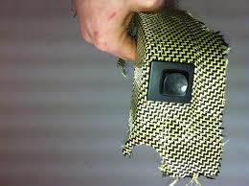
Kevlar
By : Reilly Gregorio and Devin Murray

Slide 2
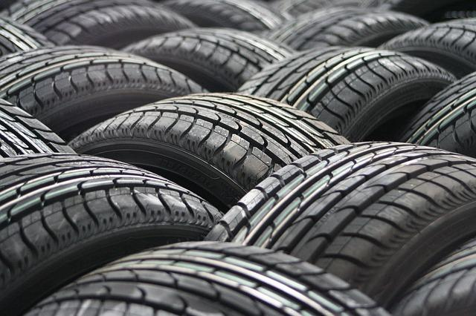
Original Invention and Patents
Kevlar was created by combining para-phenylenediamine and terephthaloyl chloride. The result was Aromatic Polyamide (aramid) threads
Kevlar was originally used for automobile tyres
DuPont was a patent of kevlar

Slide 3
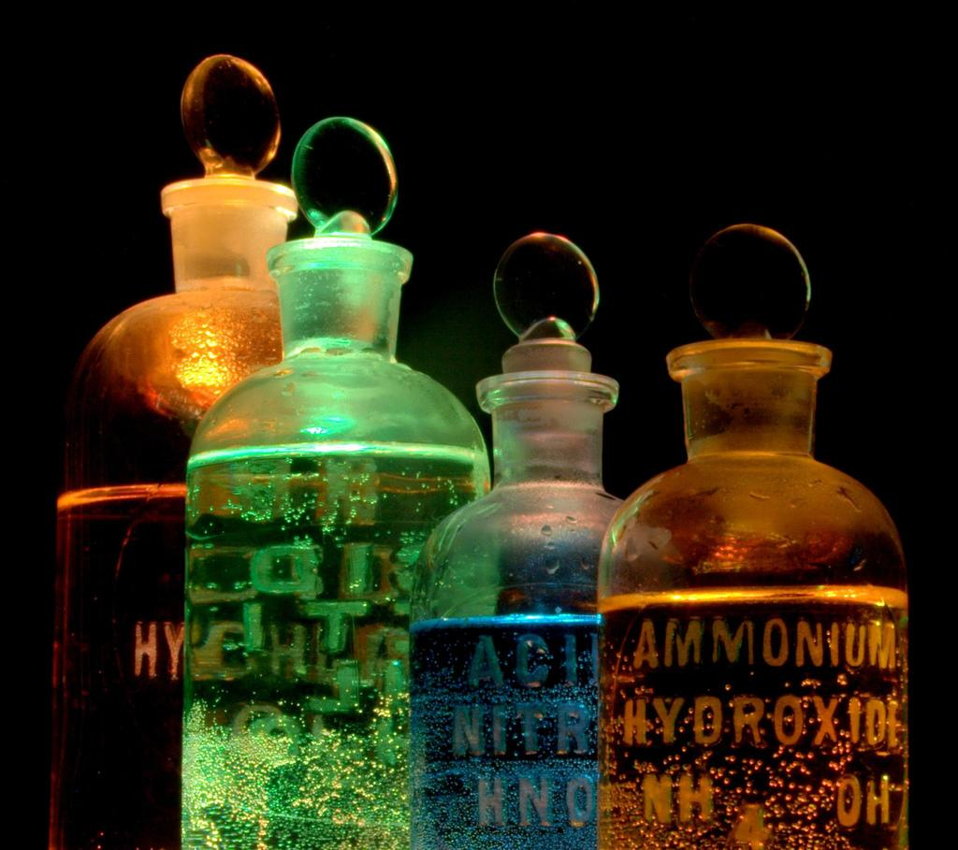
Engineering Disciplines
Chemical engineering is the discipline used for making kevlar because it was made by the combination of different chemicals. (Para-Phenylenediamine and Terephthaloyl Chloride).

Slide 4
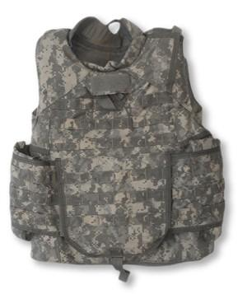
Time Line
Invented in 1965
1971: Production of kevlar
1975: Kevlar field trial
1978: Kevlar was adopted by the military
1981: Military specification
1982: Military purchases of kevlar
1993: Ranger vests made of kevlar
1994: Kelar countermine and bomb suits
1995: Kevlar correctional

Slide 5
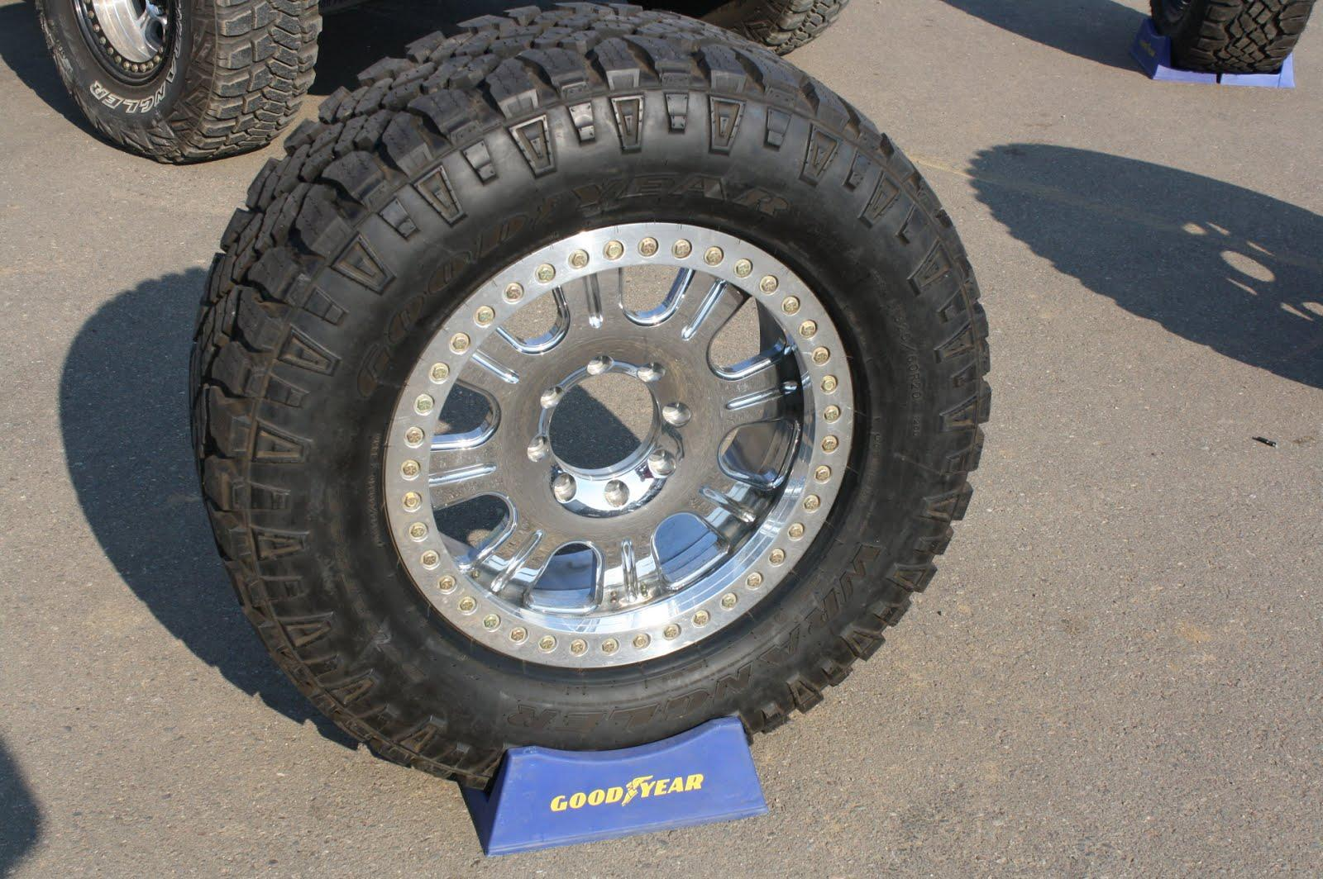
Changes
Kevlar has not changed much over the years but it has started to get used for many different products, such as:
Bullet proof vests
Bullet proof tires
Under water cables
Automobile tyres
Clothes

Slide 6
Effects
Kevlar has not had any real effect on the environment, but it has had an effect on people. Military and police officers are able to use kevlar for bullet proof vests and tires. This makes their jobs easier and safer because kevlar protects them from bullets and being stabbed.

Slide 7
Sources
http://inventors.about.com/library/inventors/blforensic3.htm#materials
http://www.dupont.com/products-and-services/fabrics-fibers-nonwovens/fibers/brands/kevlar.html
http://www.safeguardclothing.com/articles/the-history-of-kevlar/
http://composite.about.com/od/aboutcompositesplastics/l/aa050597.htm
http://timerime.com/en/timeline/83772/History+of+Kevlar/
http://www.technologystudent.com/joints/kevlar2.html

